Slide 1
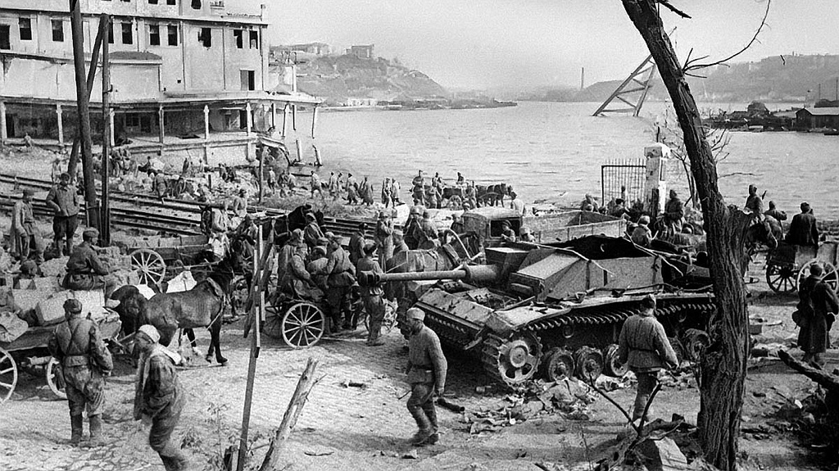
World War II
Nedbay Eva 10A

Slide 2
This is my great-grandfather Yashchuk Maxim Andreyevich. He was born in Dolinka (Ukraine) on 3 September 1925. In June 1941, 16-year-old Maxim was in his first year studying agriculture when Germany began its invasion of the Soviet Union. My grandpa and the other students were evacuated to Tomsk. In 1943 he, like many of his comrades, volunteered to be transferred to the front line.

Slide 3
My grandfather participated in the Battle of Kursk. The Battle of Kursk was a Second World War engagement between German and Soviet forces on the Eastern Front near Kursk in the Soviet Union, during July and August 1943.

Slide 4
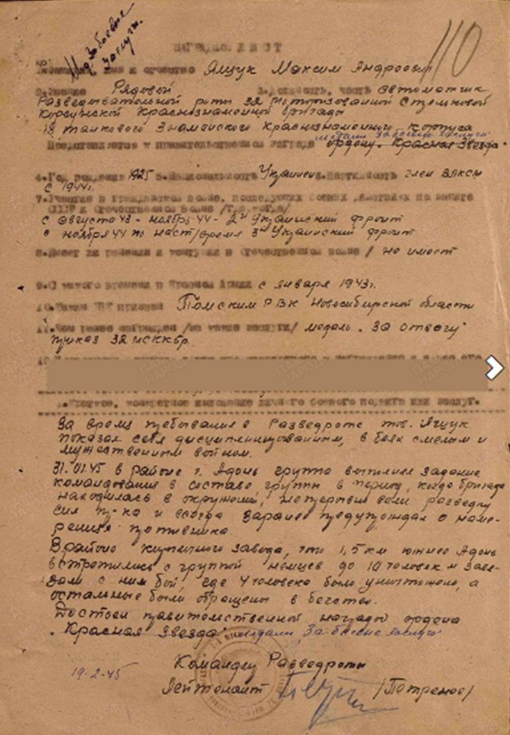
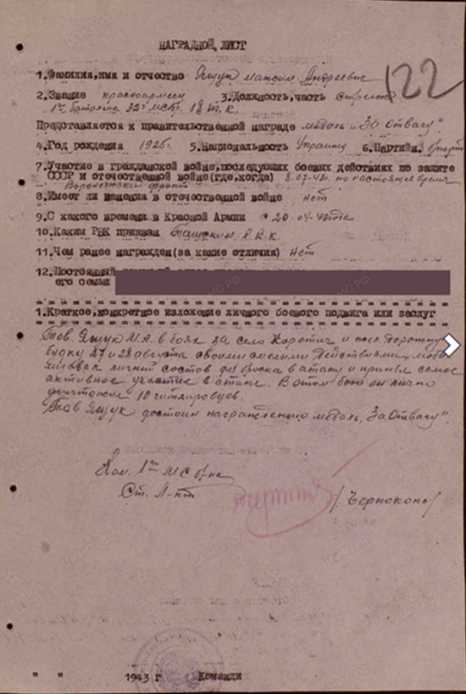
Awards: Medal "For Courage" (05.09.1943) Medal "For Battle Merit" (21.02.1945)
I found archival documents describing the exploits of my grandfather.

