Slide 1
My family in The Great Patriotic War
The presentation is done by Chernov Nikita

Slide 2
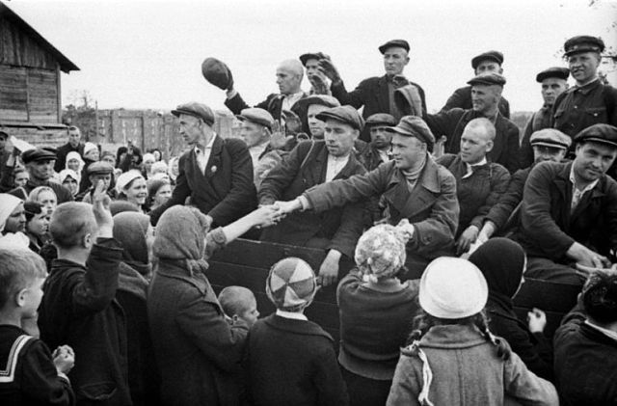
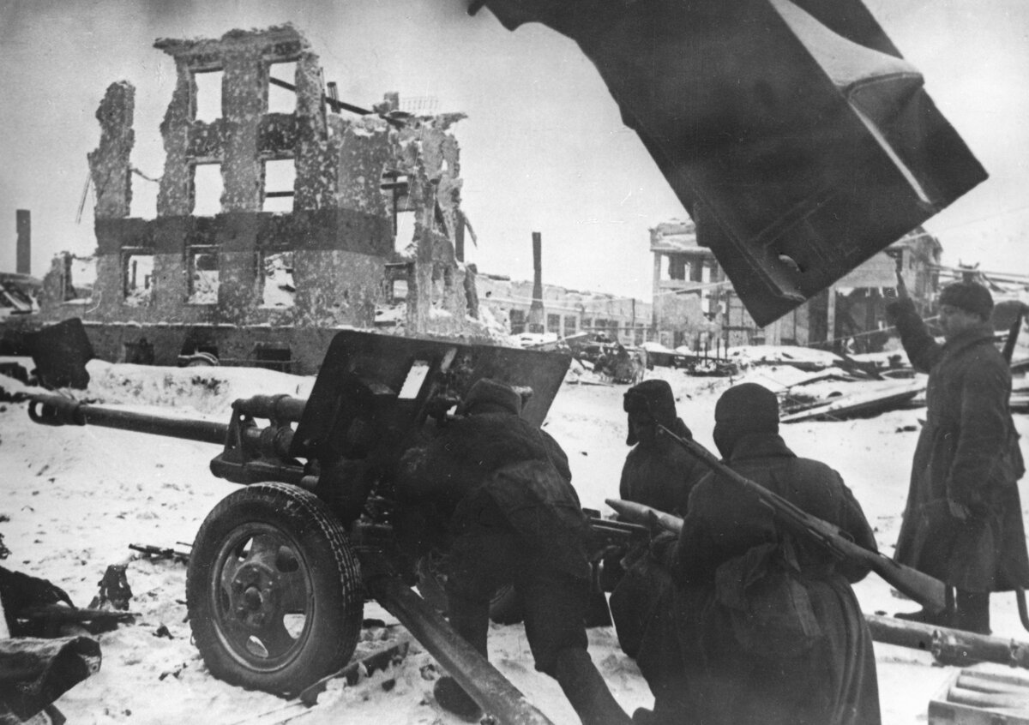
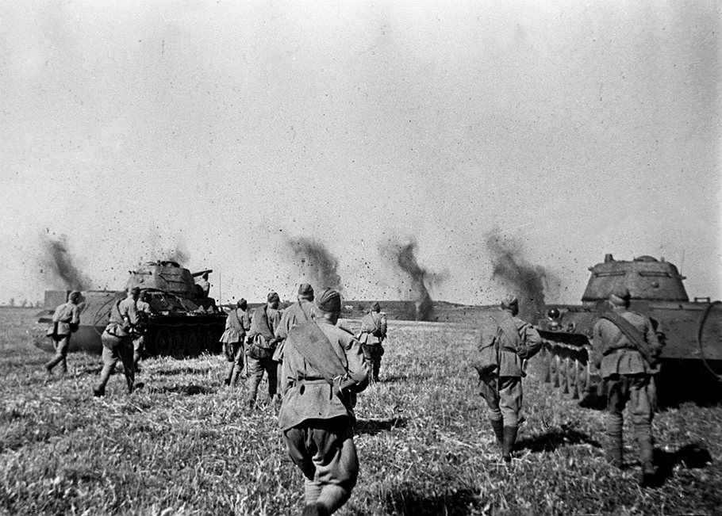
The Great Patriotic War is a war of unprecedented scale. The war of large states, the war of two political systems, the war of peoples for the basic right to live, live freely and simply live. Millions of soldiers gave their lives in an effort to defend their war and their loved ones, millions of civilians fell victim to a terrible war machine. Our duty is to preserve the memory of these historical events. Our duty is to tell future generations stories of true heroism, to give them ideals of humanism. Our duty is to prevent the recurrence of these terrible days of our history.
This presentation tells about members of my family in The Great Patriotic War.

Slide 3
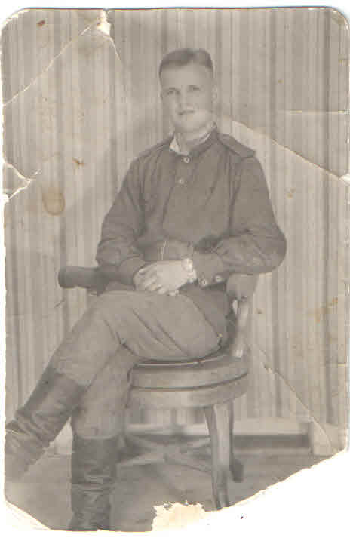
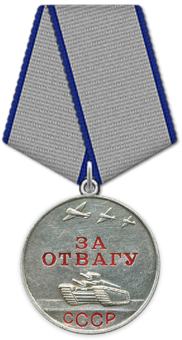
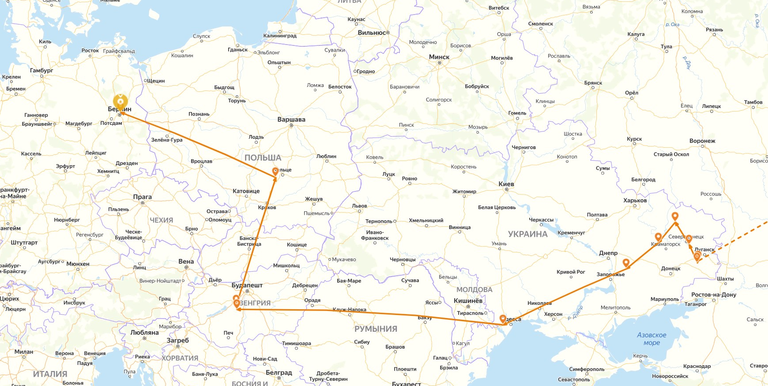
Petrovich Nikolay Mikhailovich
He was born on March 16 in 1925 in Novolugovoye village (Novosibirsk Region). In 1945, he was drafted into the reconnaissance company of 267 mortar regiment of the 1st Guards Mechanized Corps. He participated in battles in Ukraine, Hungary, Poland and Germany (an approximate map is attached below). 03/14/1945 was awarded the medal "For Courage" for detecting a cluster of infantry and enemy tanks. He is the father of my maternal grandmother

Slide 4
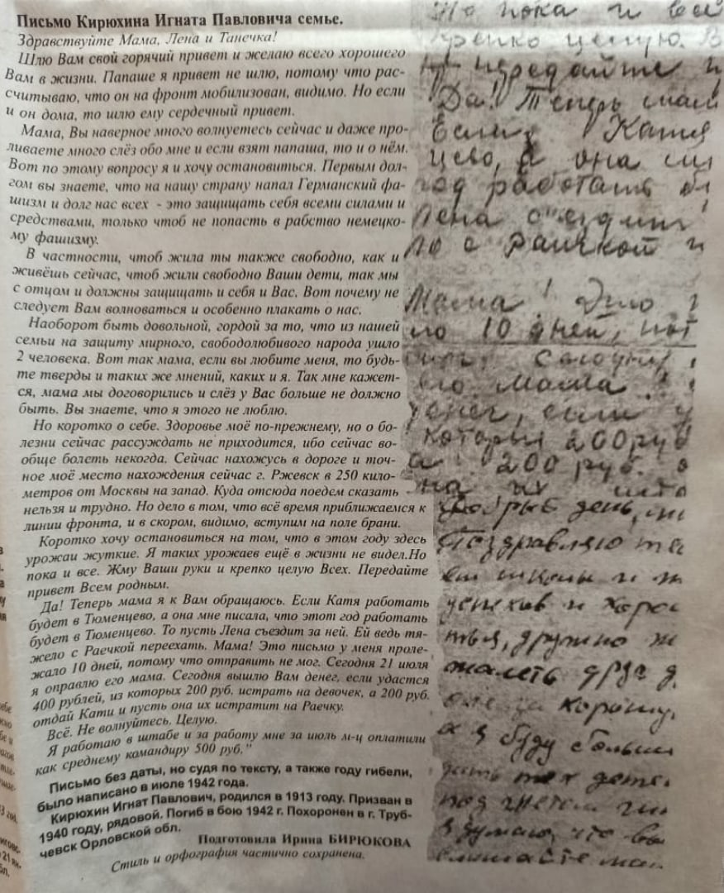
Kiryukhin Ignat Pavlovich
He was born in 1913 in the village of Tyumentsevo (Altai Territory). In 1939, together with his father, Kiryukhin Pavel Fedorovich went to serve in the army. He served as a driver-mechanic and rose to the rank of foreman at the time the war began. He died in 1942 in tank battles near the town of Trubchevsk (Bryansk Region), where he was buried in a soldier’s fashion. The official documentation is considered him missing since March 1942. He is my maternal uncle on my paternal side.
There is a letter, which he wrote to the family. In this letter he asked his mother to be proud about him and not to worry about his life.

Slide 5
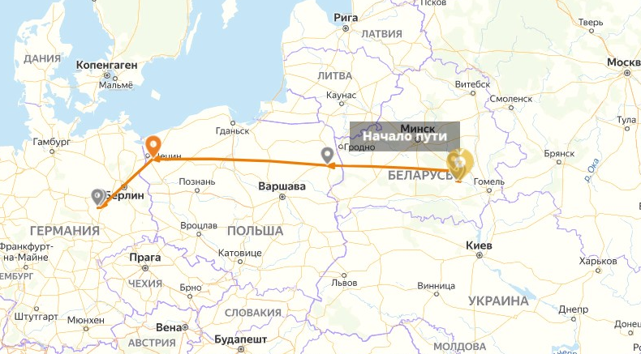
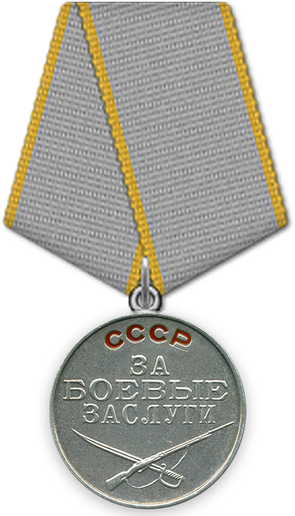
Ryapolov Vasily Mitrofanovich
He was born in 1925 in the village of Cheremshanka (Altai Territory). He was drafted on January 7, 1943 into the 181 Guards Rifle Division, and on June 16, 1943 he was transferred to the 241 Guards Rifle Regiment. On September 9, 1943 was awarded the medal "For Military Merit" after the offensive operation near Smolensk. In addition, he participated in battles in Belarus, Poland, Germany (below is an approximate map). During the fighting he was wounded in the arm. He is the father of my paternal grandmother.

Slide 6
Chernov Boris Fedorovich
He was born in 1898 in Altai. Due to active participation in the partisan cell in Altai during the Civil War, he was released from military operations, but went to the front with a truck driver. He is the father of my paternal grandfather.

Slide 7
Our ancestors made a lot in order to give as freely and peaceful life. Their feat is priceless. And all we can do is to tell their stories to future generations in order to make memory of them immortal.

