Slide 1
«Alexander Pokryshkin»
project on
Authors:
11th grade students
Sibikina M.
Antonova M.
Novosibirsk
2020

Slide 2
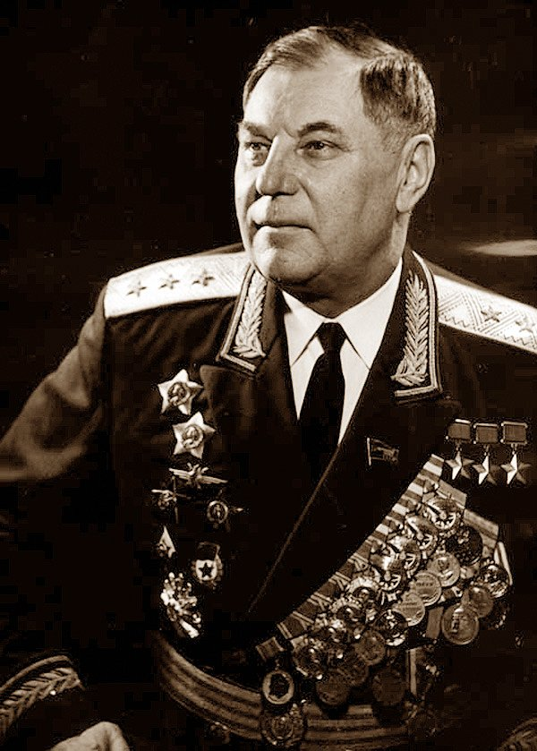
Alexander Ivanovich Pokryshkin
(19 March 1913 – 13 November 1985)
- was one of the highest-scoring Soviet aces, and earned the title Hero of the Soviet Union three times: 24 May 1943, 24 August 1943, and 19 August 1944. After the war he reached the rank of Marshal of Aviation.

Slide 3
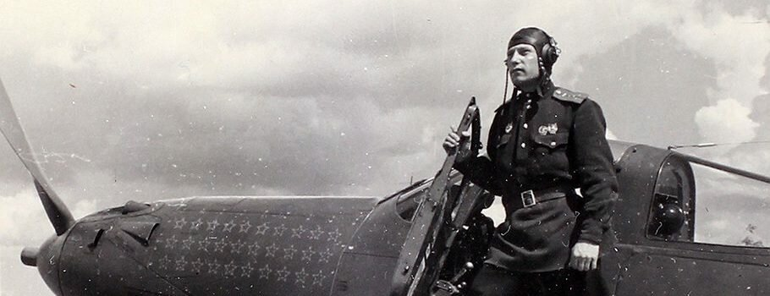
During the war he strongly promoted the training in and use of improved aerial combat techniques that included vertical maneuvers that newer fighter aircraft were capable of carrying out, and he spent much of his time studying aerobatics for combat situations.

Slide 4
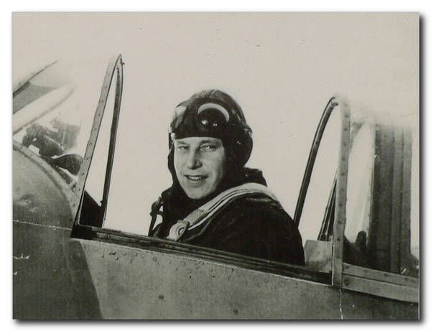
Film!!!
Pokryshkin is a national hero and how to do without films dedicated to him? There are a lot of such films, personally we liked the film "Alexander Pokryshkin" created in 1985.

Slide 5
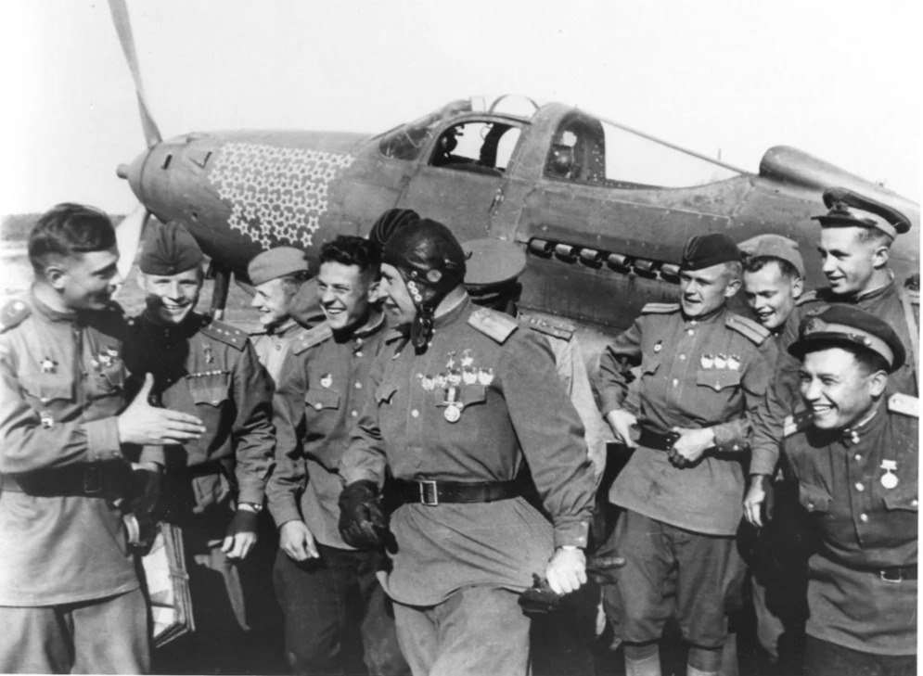
We offer…
We are proud of the past of our homeland and it would be great if the modern generation did not forget it. Therefore, we offer lessons dedicated to our countryman with watching a movie, a quiz on the film (questions are attached)

Slide 6
Quiz for the film «A. I. Pokryshkin »
How many enemy aircraft did A.I. Pokryshkin bring down? (59 pcs.)
When was Pokryshkin sent on a Komsomol ticket to the military aviation school of aircraft technicians? (1932)
How many planes were shot down by Mikhail Devyatayev? (9 and one hijacked)
How long will it take a person to respond to any event? (0.5sec)
What was the call of Pokryshkin in battle? (Сашка/Сотка)
The year of transition of the point of strategic dominance in the sky of Soviet pilots over the Luftwaffe pilots. (summer 1943)
Who was Pokryshkin’s wife in the war? (Nurse)
What should be a “real” pilot? (Detailed response)
How do Pokryshkin's students describe their teacher? (Detailed response)

Slide 7
The end
thank you for your attention

