Slide 1
The 9th of May – Victory day
The presentation made by
Tatyana Kondrateva and Ann Nikulinskikh,
10 «A»

Slide 2
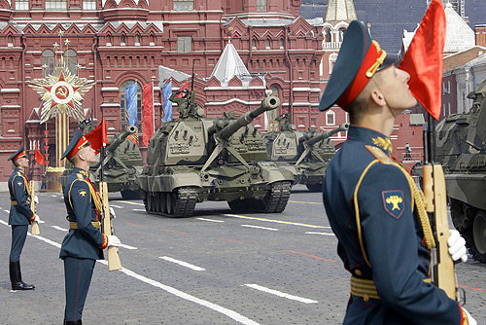
The holiday of the victory of the people of the Soviet Union over Nazi Germany in the Great Patriotic War of 1941-1945 celebrated on May 9th.

Slide 3
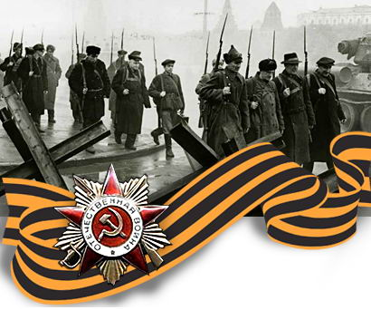
War always starts suddenly, 22nd of June in 1941, the most terrible war began - the Great Patriotic War. Soviet Union was declared a state of emergency, mobilized an army. It lasted 4 fateful years. The spirit of patriotism and perseverance were the hallmarks of Russian soldier.

Slide 4
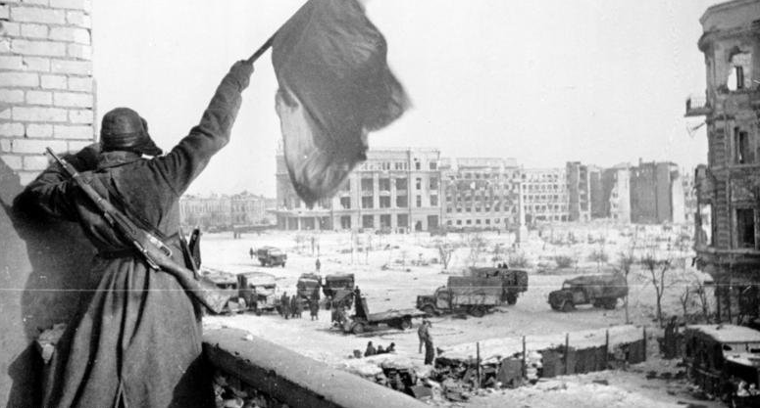
The Berlin operation of 1945 involved over 2.5 million soldiers and officers, 6,250 tanks and self-propelled guns, 7,500 aircraft. The losses turned out to be huge: according to official figures, the Red Army lost more than 15 thousand soldiers and officers per day. In total, in the Berlin operation, Soviet troops lost 352 thousand people.

Slide 5
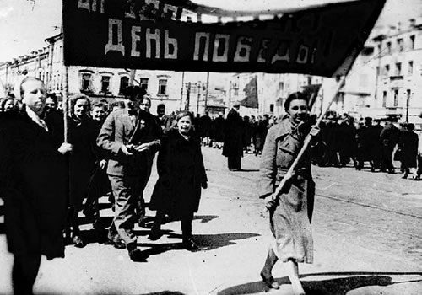
And on June 24, Victory Parade was held on Red Square in Moscow. The parade was commanded by Marshal Konstantin Rokossovsky, the parade was taken by Marshal George Zhukov.

Slide 6
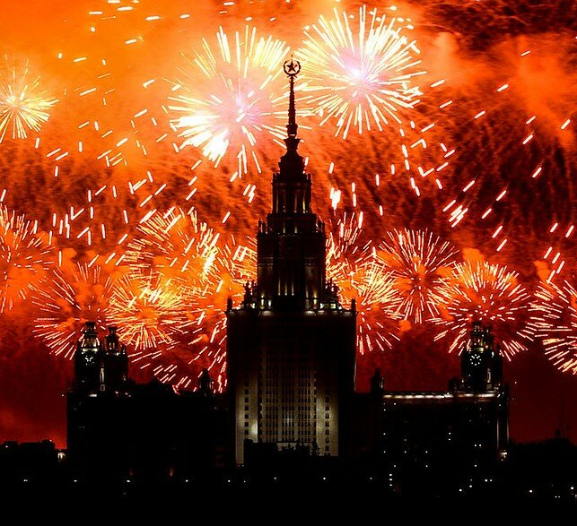
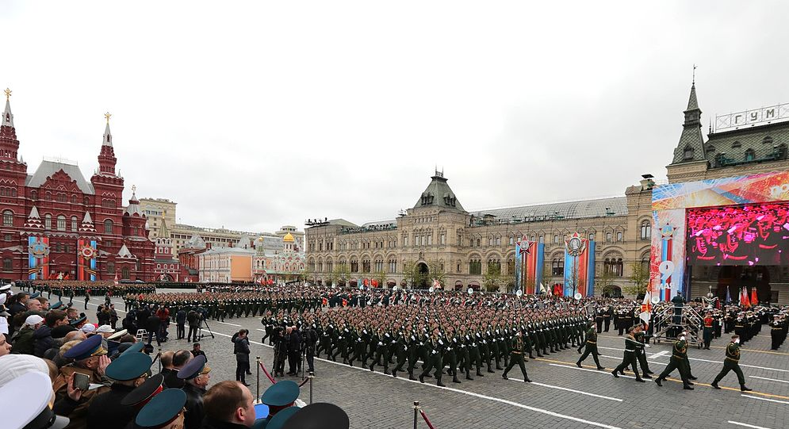
The 1st celebration of Victory Day which was held on the 9th of May in 1945 was completed by great firework. Salute became a tradition. Then the military parade was held on the 24th of June in 1945. Nowadays the military parade is the important part of the celebration of 9th May.

Slide 7
