Slide 1
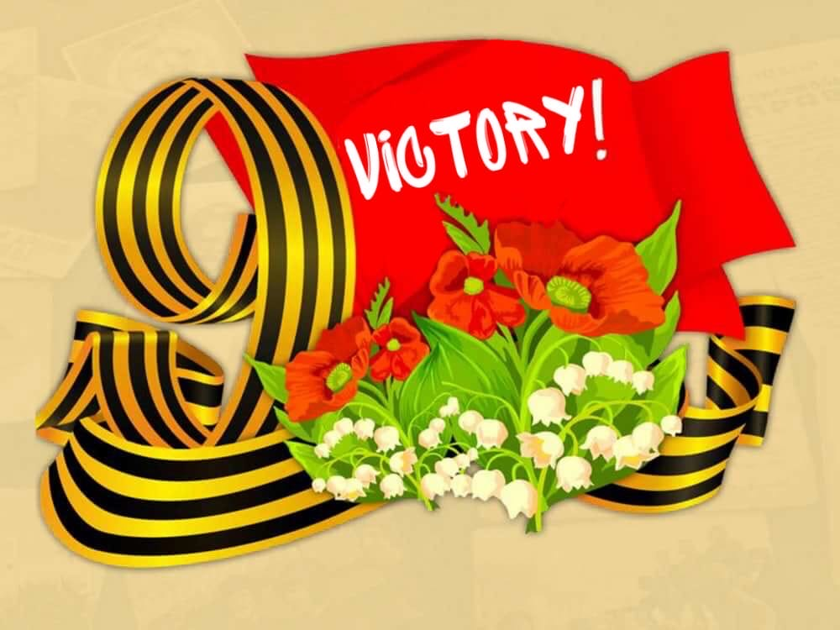
Chernyshova Varvara
Panagushina Olga 10V

Slide 2
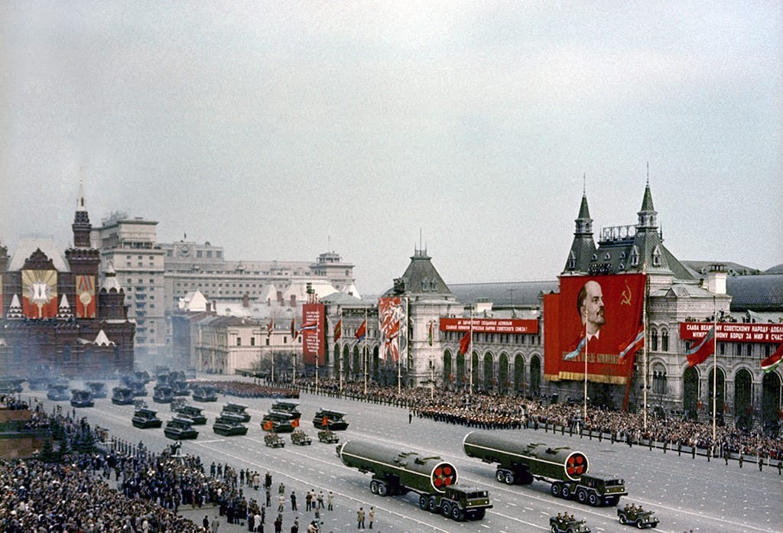
In 1965, on the 20th anniversary of the Victory, the first parade took place, namely on May 9, dedicated to the victory of the Great Patriotic War (1941-1945). This date became a national holiday and a day off. Then the Victory Banner was first carried across Red Square.

Slide 3
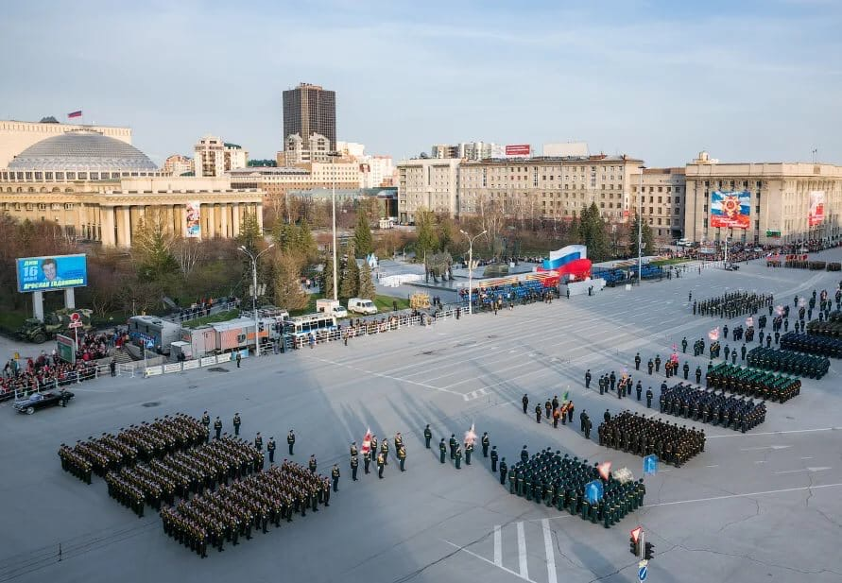
In Novosibirsk, by tradition, Victory Day is celebrated in Lenin Square. Every year at 10.00 a military parade of the troops of the Siberian garrison takes place on Lenin Square.

Slide 4
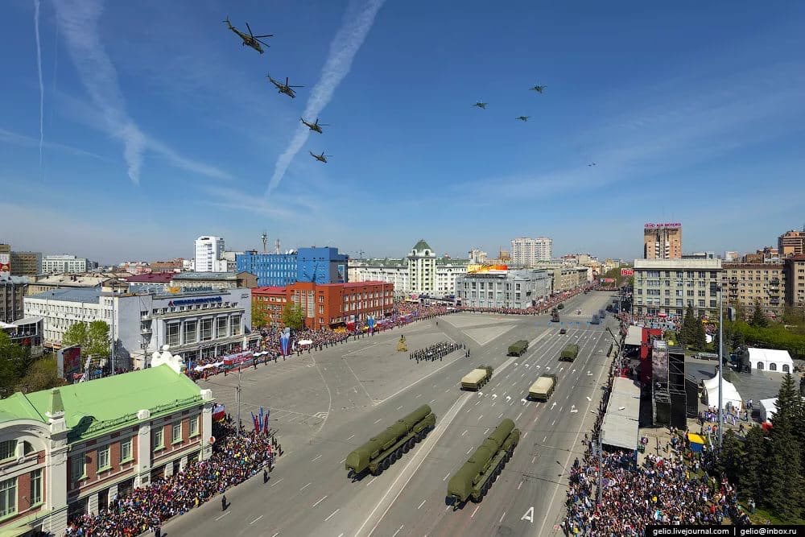
It involves participants in the personnel of the Ministry of Defense of the Russian Federation and other structures of law enforcement agencies, as well as military equipment.

Slide 5
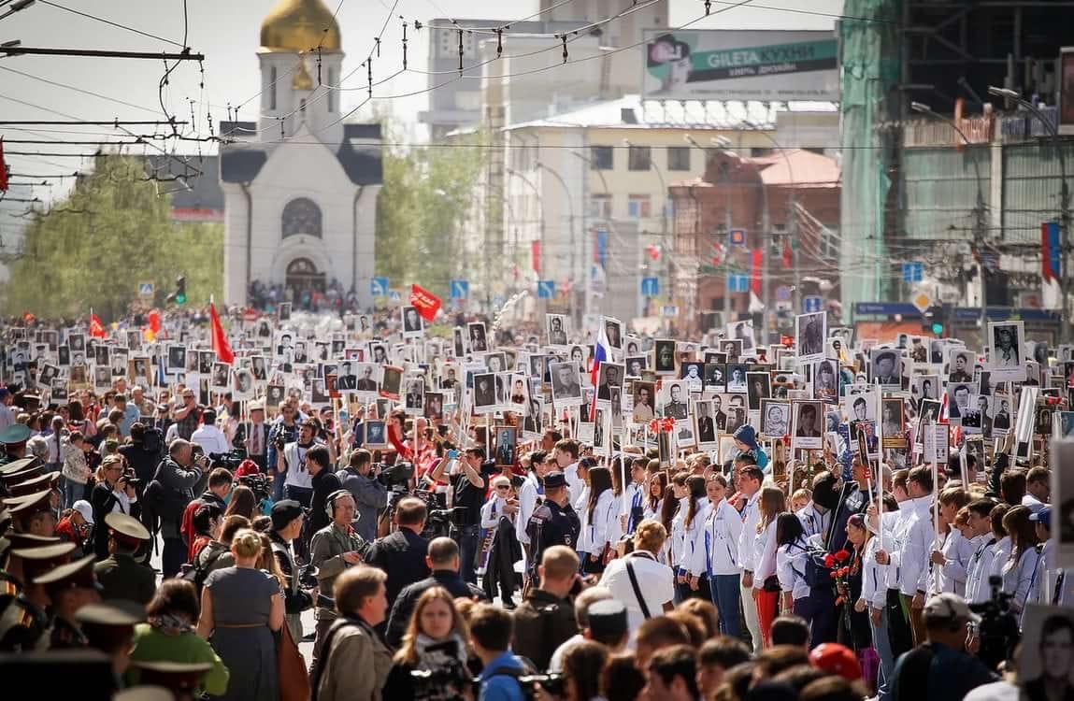
After the parade, an immortal regiment is held, and then the laying of wreaths at the Eternal Flame. Victory Day ends with festive fireworks in the evening.

Slide 6
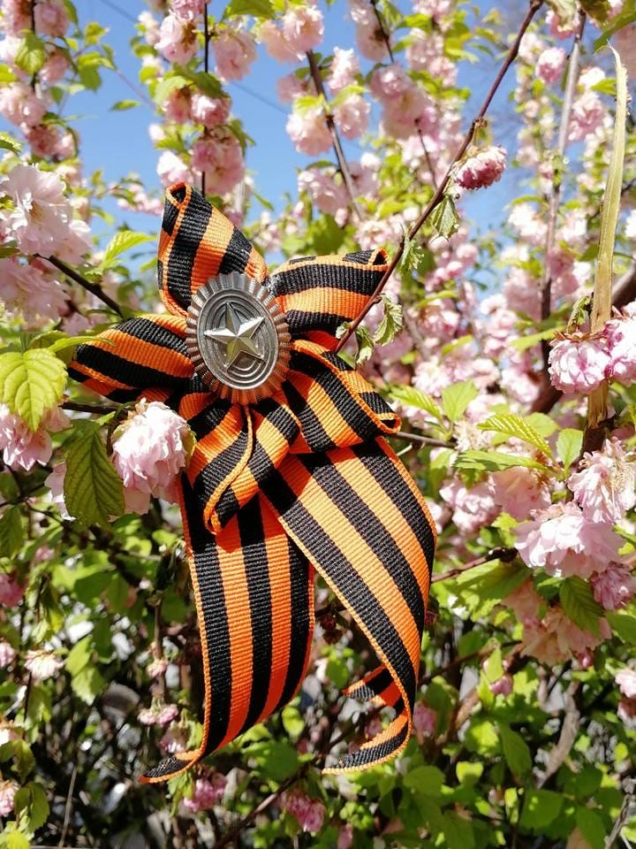
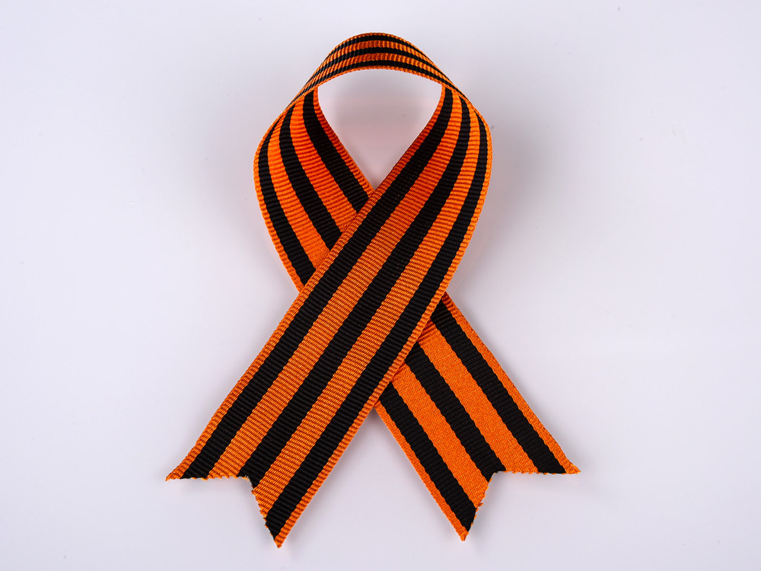
St. George Ribbon - is one of the main attributes of Victory Day in Great Patriotic War . This symbol is an expression of our respect for veterans and all those thanks to whom we won in 1945. The St. George ribbon is usually worn on the chest on the left. The colors of the tape are black - the color of smoke and orange - the color of the flame.

Slide 7
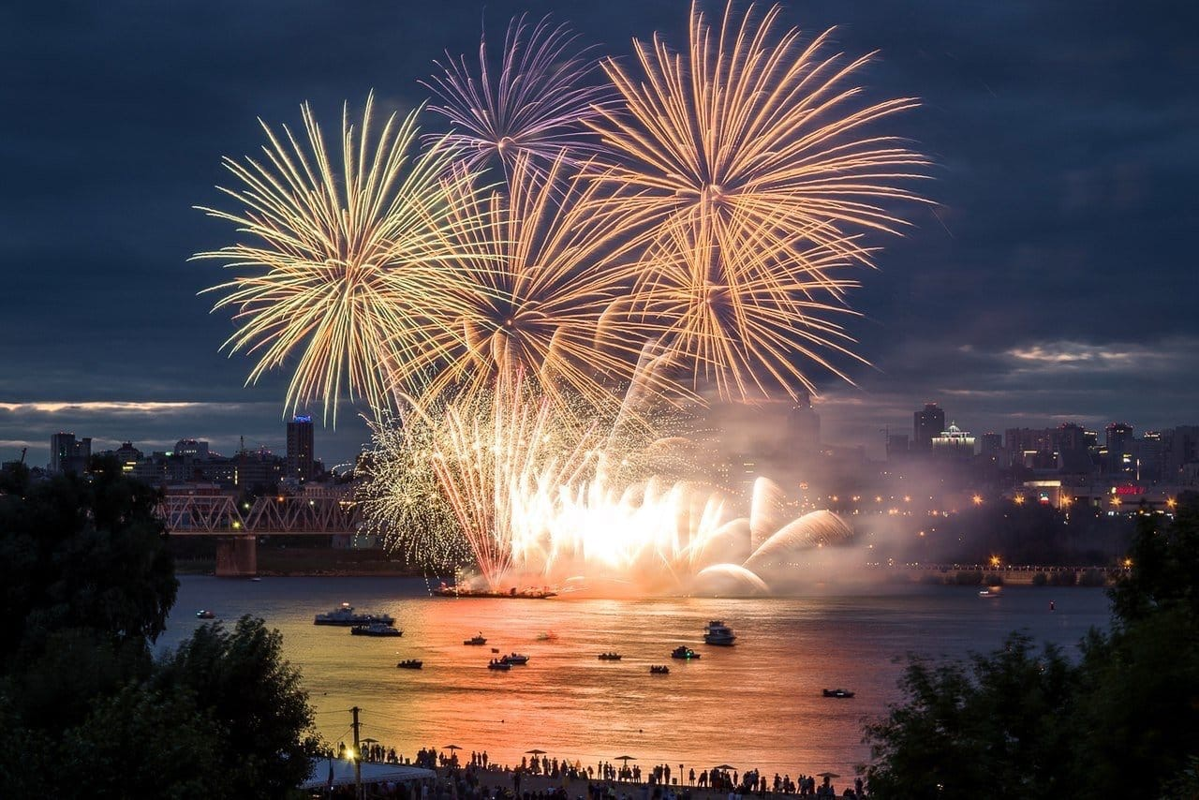
Thanks for your attention!!!

